Slide 1
Systems Biology of Human Metabolism and Gut Microbiome
2 Oct, 2018 at Albanova University Center
”Mechanisms and Consequences of Fatty Liver Disease”
Jan Borén, MD, PhD
Department of Molecular and Clinical Medicine
Wallenberg Laboratory for cardiovascular and Metabolic Research
Sahlgrenska University Hospital
University of Gothenburg, Sweden

Slide 2
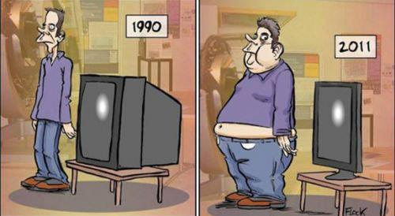
Prevalence of CHD risk factors: an evolving landscape
1990
2018
Hypercholesterolemia
Smoking
Hypertension
Hypertriglyceridemia
Type 2 diabetes
Overweight & obesity

Slide 3
Dyslipidemia in obesity, type 2 diabetes and insulin resistance
Elevation of serum triglycerides
Excessive postprandial lipemia and accumulation of remnant particles
Lowering of HDL cholesterol
Preponderance of small, dense LDL
2017

Slide 4
Dyslipidemia in obesity, type 2 diabetes and insulin resistance
Elevation of serum triglycerides
Excessive postprandial lipemia and accumulation of remnant particles
Lowering of HDL cholesterol
Preponderance of small, dense LDL
2018
A cluster of lipid and lipoprotein abnormalities that
are metabolically interrelated

Slide 5

What’s the underlying mechanism(s) for the dyslipidemia?

Slide 6
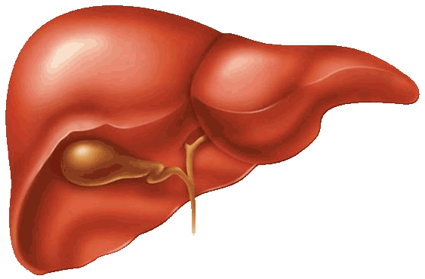
Metabolism of triglyceride-rich apolipoprotein B-containing lipoproteins
Intestinal
cell
VLDL
LPL
Chylomicron
Chylomicron
remnant
IDL
LPL
LDL
Capillaries
LPL
LPL, lipoprotein lipase; HL, hepatic lipase; VLDL, very low density lipoprotein; IDL, intermediate density lipoprotein, LDL, low density lipoprotein

Slide 7
Metabolism of triglyceride-rich apolipoprotein B-containing lipoproteins
Intestinal
cell
VLDL
Chylomicron
Chylomicron
remnant
IDL
LDL
Atherogenic lipoprotens
LPL, lipoprotein lipase; HL, hepatic lipase; VLDL, very low density lipoprotein; IDL, intermediate density lipoprotein, LDL, low density lipoprotein

Slide 8
The liver secretes two forms of VLDL
Larger triglyceride-rich VLDL₁ and smaller VLDL₂
Type 2 DM patients
3
VLDL₁ TG
VLDL₂ TG
2
VLDL₁
VLDL₁/VLDL₂ TG (mmol/l)
VLDL₂
VLDL₂
1
0
0
1
2
3
4
5
Total TG (mmol/l)
VLDL₁ TG is a major determinant of
plasma triglyceride level

Slide 9
Kinetic studies to elucidate disturbed lipoprotein metabolism
Concentrations provide only a static estimate of metabolism
Provide NO information about the mechanisms that determine concentration
Concentration
Secretion
Catabolism
Kinetic Studies

Slide 10

Mechanistic understanding opens up the possibility of personalized medicine in the future
optimal treatment to prevent the development of morbidity and mortality

Slide 11
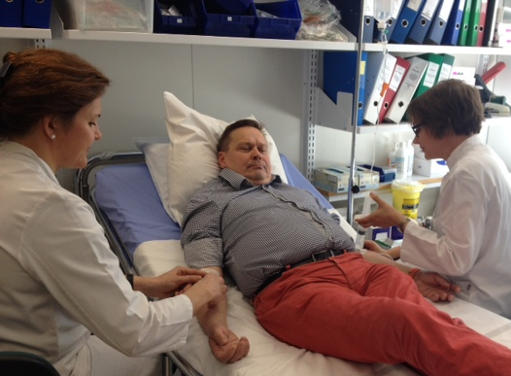
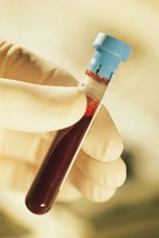
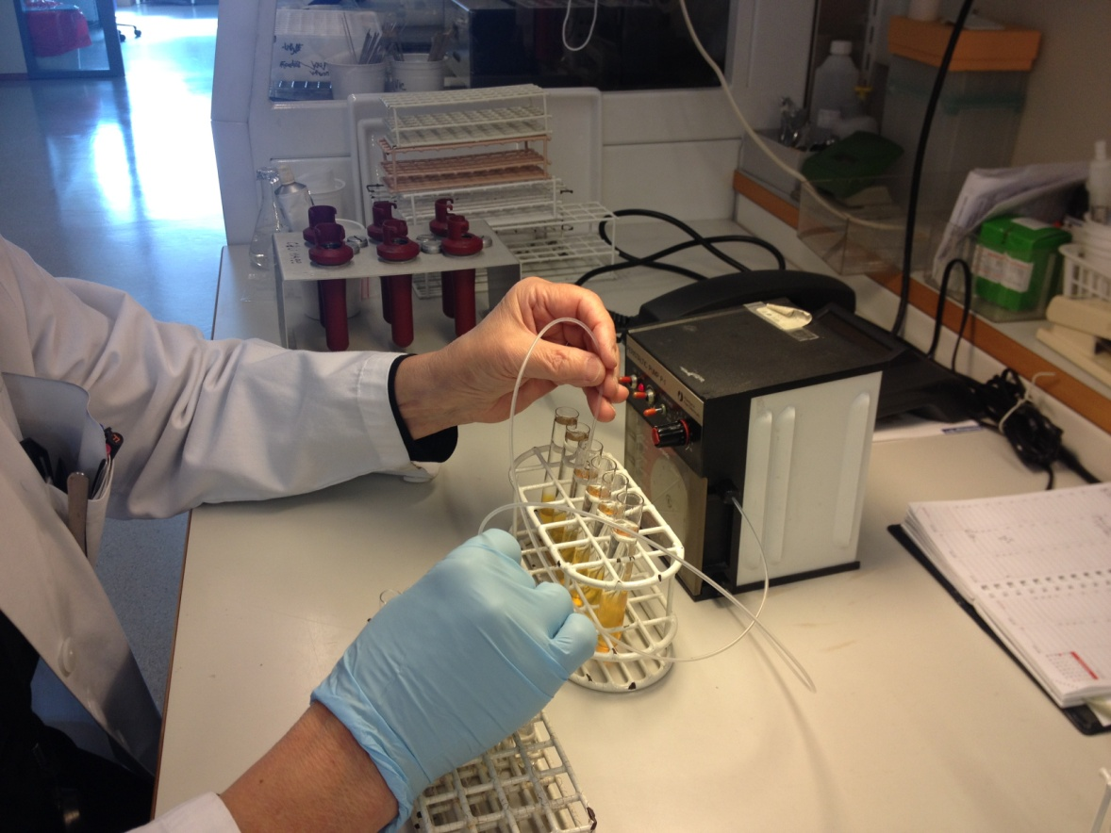
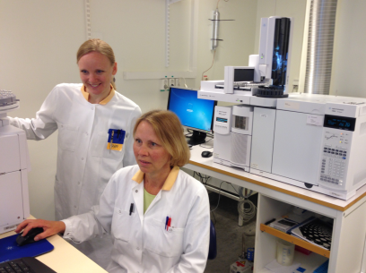
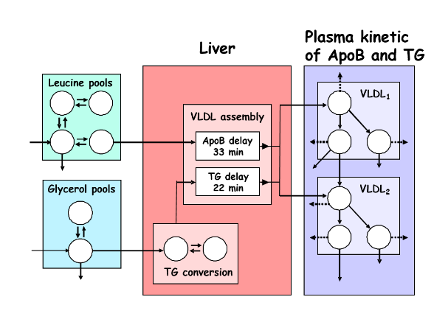
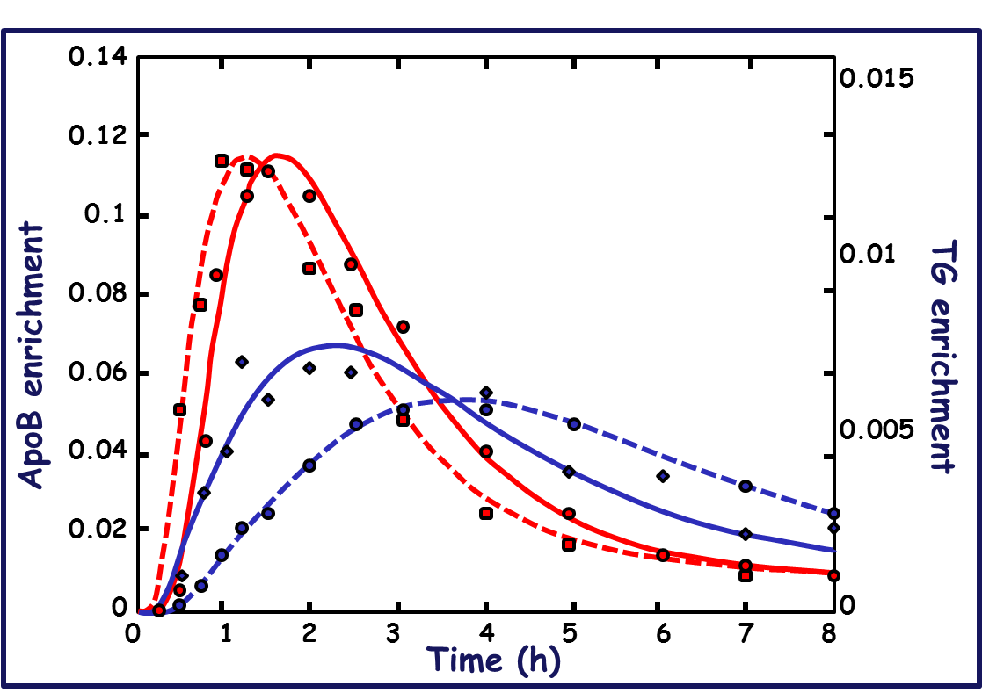
Multiple Steps in Kinetic Studies
DGU
Injection of stable isotopes
Fasting bloods collection, up to 96 hours
VLDL₁, VLDL₂, LDL
Mathematical modelling to estimate kinetic parameters for:
Secretion (production rate); rate at which protein moves through a pool
Turn-over (fractional catabolic rate); fraction of the protein lost from a pool per unit time
VLDL1
Gas chromatography-mass spectrometry
VLDL2
Generate tracer data

Slide 12
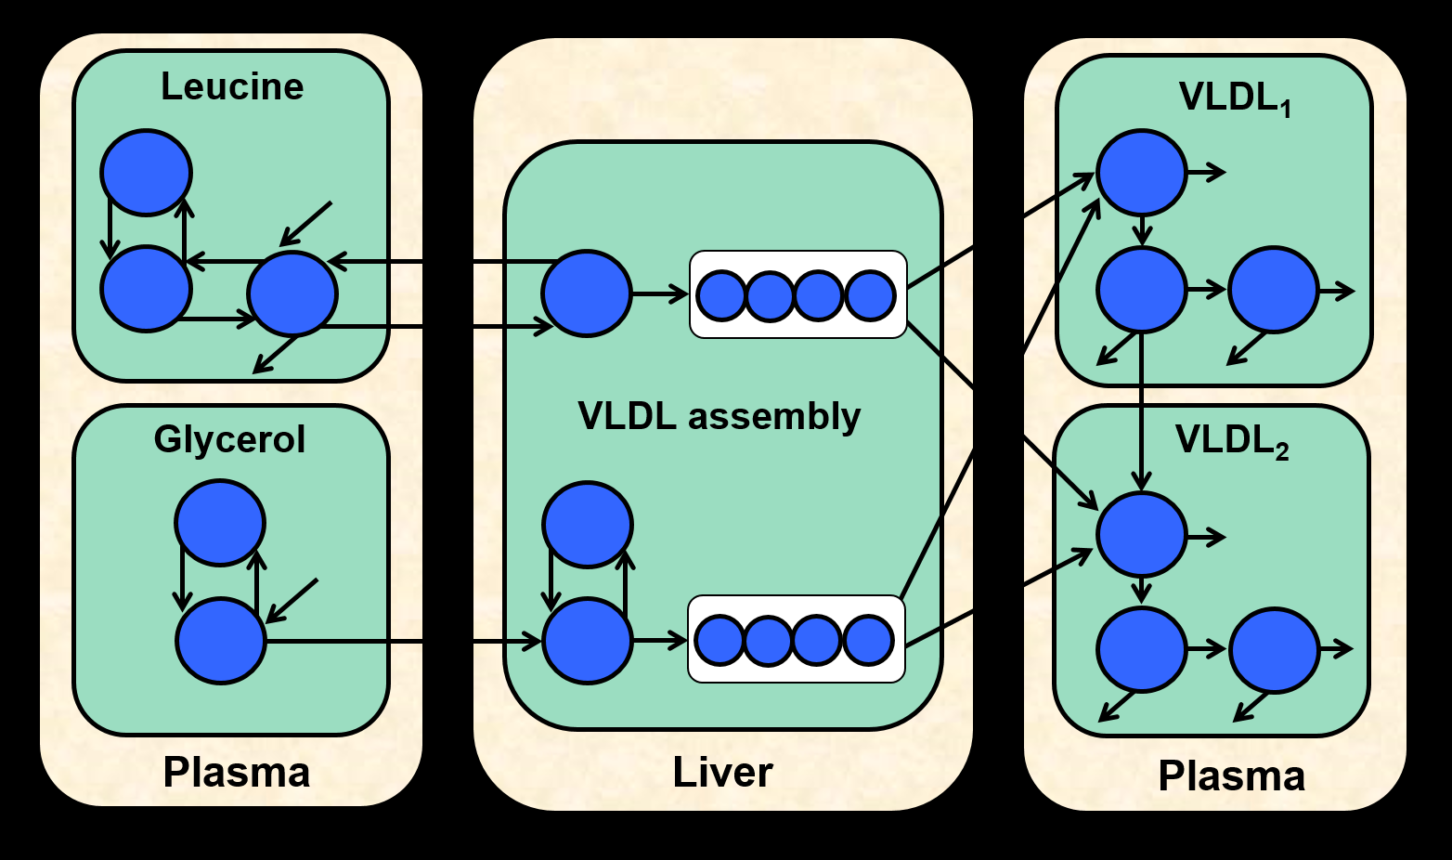
Kinetic studies of lipoprotein metabolism multicompartmental modeling using isotopic enrichment data
Enrichment of stable isotopes in VLDL-apoB and VLDL-TG
Combined multicompartmental model for apoB100 and TG metabolism in VLDL subspecies
Estimate kinetic parameters for secretion and turn-over
Adiels M et al. Frontiers in Physiology 2015;6:342

Slide 13
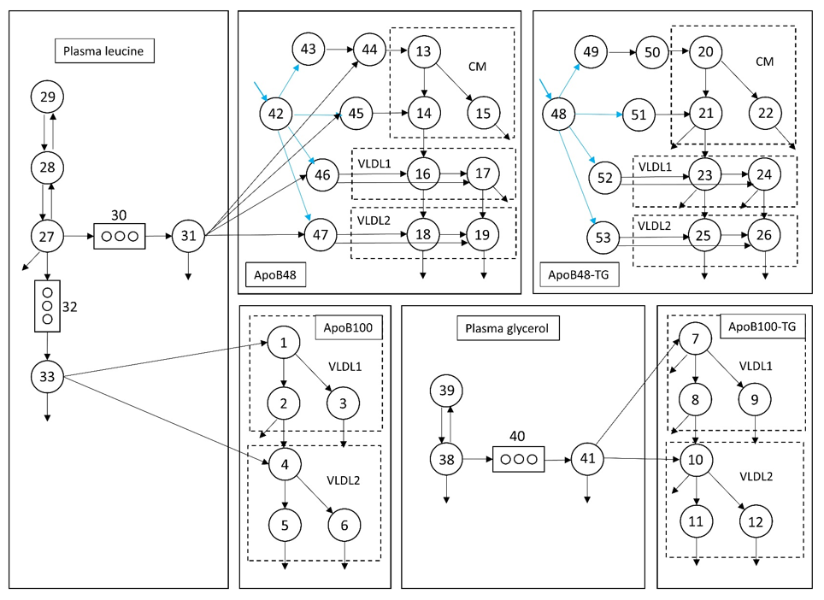
Kinetic studies of lipoprotein metabolism non-steady state modeling of postprandial lipid metabolism
SAAM; soft-ware designed for modeling, simulating, and analyzing kinetic data
Björnson E et al., submitted 2018

Slide 14
Identification of predictors of VLDL₁ TG production in stable isotope kinetic studies
Variable
Beta
SE
Significance
Liver fat (NAFLD)
Plasma glucose
Insulin
Adiponectin
Total abdominal fat
Subcutaneous fat
Intra-abdominal fat
0.22
0.80
0.092
0.38
0.025
0.050
0.49
0.86
0.86
0.50
0.57
Hepatic overproduction of large VLDL is driven by
hepatic TG accumulation and hyperglycemia
Adiels M et al. Diabetologia 2006

Slide 15
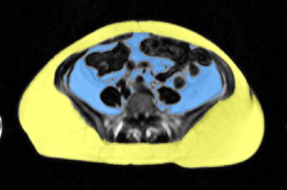
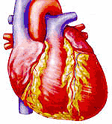
Dysfunctional adipose tissue leads to ectopic fat accummulation and increased CVD risk
Caloric Intake
and/
or
Energy Expenditure
Positive Energy Balance
Capacity of AT
to expand
Inflamed
Adipose tissue
Lipid overflow
Visceral
adiposite
Liver fat
Epi-,pericardial-
and myocardial fat
Muscle
fat
Pancreatic
fat
Increased risk of cardiovascular disease
Tchernof A and Després J-P. Physiol Rev.93:359-404,2013

Slide 16
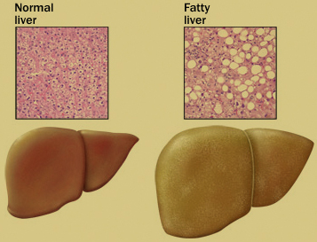
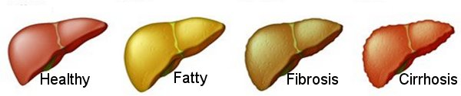
Nonalcoholic fatty liver disease (NAFLD)
A major cardiometabolic risk factor
defined >5% liver fat
≈25% of adults have NAFLD
prevalence 70–90% in subjects with obesity or T2D
may progress to severe liver diseases
the most common cause of death in patients with NAFLD is cardiovascular disease

Slide 17
Fatty liver associates with hyperlipidemia and CVD. What is the underlying mechanism?

Slide 18
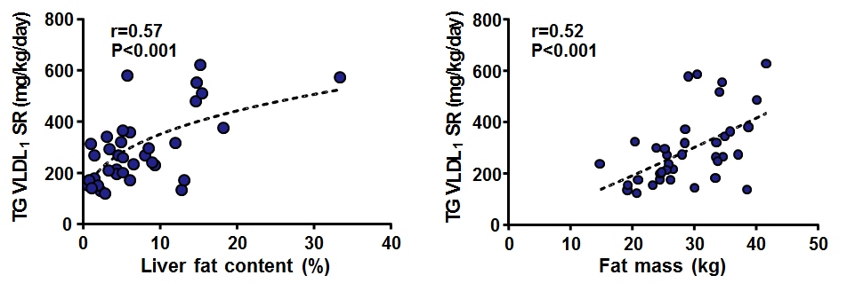
Elucidation of the dysregulation of the VLDL₁-TG metabolism in NAFLD subjects
Increased secretion of VLDL₁
SECRETION pathway
Liver fat
0.56***
VLDL₁ SR
0.44**
Plasma TG
0.51***
Fat mass
Multicenter study in 46 subjects with abdominal obesity and additional cardiometabolic risk factors
Borén et al ATVB, 2015; 35:2218-24

Slide 19
Elucidation of the dysregulation of the VLDL₁-TG metabolism in NAFLD subjects
Increased secretion of VLDL₁
SECRETION pathway
Liver fat
0.56***
VLDL₁ SR
0.44**
Plasma TG
0.51***
Fat mass
≈ 20% of variation of plasma TG
Borén et al ATVB, 2015; 35:2218-24

Slide 20
Elucidation of the dysregulation of the VLDL₁-TG metabolism in NAFLD subjects
…and impaired removal
SECRETION pathway
Clearance pathway
Liver fat
0.56***
0.84***
ApoC-III
VLDL₁ SR
0.44**
Plasma TG
−0.48***
0.51***
−0.49***
VLDL₁ FCR
Fat mass
≈ 20% of variation of plasma TG
≈ 50% of variation of plasma TG
Borén et al ATVB, 2015; 35:2218-24

Slide 21
Metabolism of triglyceride-rich apolipoprotein B-containing lipoproteins
Intestinal
cell
VLDL
LPL
Chylomicron
Chylomicron
remnant
IDL
LPL
LDL
Capillaries
LPL
LPL, lipoprotein lipase; HL, hepatic lipase; VLDL, very low density lipoprotein; IDL, intermediate density lipoprotein, LDL, low density lipoprotein

Slide 22
Dual metabolic defects underlying the dyslipidemia Increased VLDL₁ synthesis and impaired removal of TRLs
Intestinal
cell
VLDL
LPL
Chylomicron
Chylomicron
remnant
IDL
LPL
LDL
Capillaries
LPL

Slide 23
Low HDL cholesterol is a consequence of increased plasma TRLs
SECRETION pathway
Clearance pathway
Liver fat
0.56***
0.84***
ApoC-III
VLDL₁ SR
0.44**
Plasma TG
−0.48***
0.51***
0.50****
−0.49***
VLDL₁ FCR
Fat mass
ApoA-I FCR
Plasma HDL chol
Borén et al ATVB, 2015; 35:2218-24

Slide 24
Dyslipidemia in obesity, type 2 diabetes and insulin resistance
Elevation of serum triglycerides
Excessive postprandial lipemia and accumulation of remnant particles
Lowering of HDL cholesterol
Preponderance of small, dense LDL
2017

Slide 25
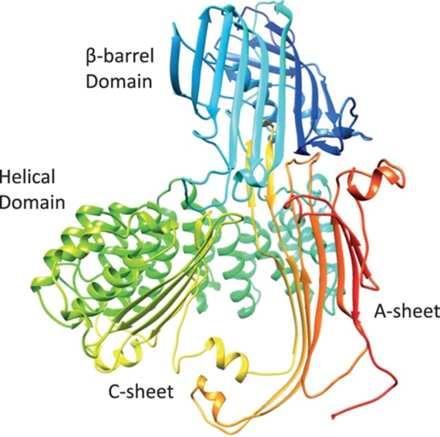
ApoC-III plays an important role in metabolism of triglyceride-rich lipoproteins
ApoC-III inhibits lipoprotein lipase (LPL) and plays a critical role in the hydrolysis and clearance of TRLs
Inhibits hepatic clearance of remnant particles
May regulate hepatic VLDL production
ApoC-III is a strong predictor of cardiovascular risk
Expression in vitro induced by glucose (via HNF-4α and ChREBP)

Slide 26
ApoCIII – a critical regulator or triglyceride metabolism
Why is apoC-III increased?

Slide 27
Characteristics of the study subjects
Non-diabetic subjects n=11
Type 2 Diabetic subjects
n=11
Mean
SD
Mean
SD
P-value
Age (yrs)
Diabetes duration (yrs)
BMI (kg/m²)
HbA_{1C%}
P-glucose (mmol/L)
S-insulin (mU/L)
Triglycerides (mmol/L)
Cholesterol (mmol/L)*
LDL-C (mmol/L)*
HDL-C (mmol/L)
58.7
30.4
5.6
5.66
73.5
1.48
5.19
3.59
1.10
5.6
2.8
0.3
0.36
45.2
0.54
0.68
0.64
0.41
60.5
6.6
31.9
6.9
9.35
19.2
1.90
3.89
2.13
1.13
6.1
4.0
3.7
0.7
2.52
9.1
0.73
0.79
0.79
0.24
NS
-
NS
p<0.001
p<0.001
p<0.01
NS
p<0.001
p<0.001
NS
*statin effect
Adiels M et al., submitted 2018

Slide 28
Parameters of glycemic control and serum triglycerides
Non-DM2
DM2
p: <0.001
p: <0.001
p: 0.22
8
12
2.5
10
7
2.0
P-glucose (mmol/L)
HbA1C (%)
TG (mmol/l)
8
1.5
6
6
1.0
5
Non-DM2
DM2
Non-DM2
DM2
Non-DM2
DM2
Adiels M et al., submitted 2018

Slide 29
Fatty liver and DNL rate are markedly increased in diabetes
Non-DM2
DM2
p: 0.043
p: 0.82
p: 0.0021
5
40
30
4
30
20
3
20
Liver fat (%)
3-OHB (mg/dl)
V1 DNL baseline (%)
2
10
10
1
0
0
Non-DM2
DM2
Non-DM2
DM2
Non-DM2
DM2
Adiels M et al., submitted 2018

Slide 30
ApoC-III is a strong determinant of plasma triglycerides concentrations
Non-DM2
DM2
r= 0.83
p<0.001
2
TG (mmol/l)
1
5
10
15
ApoC-III (mg/dl)
Adiels M et al., submitted 2018

Slide 31
Impact of diabetes on apoC-III dynamics
Non-DM2
DM2
p: 0.0014
12.5
10.0
ApoC-III SR (mg/kg/day)
7.5
5.0
2.5
Non-DM2
DM2
Adiels M et al., submitted 2018

Slide 32
Secretion rate of apoC-III is the major determinant of plasma apoC-III levels
Non-DM2
DM2
r= 0.67
p<0.001
r=-0.33
p= 0.13
20
15
15
ApoC-III (mg/dl)
ApoC-III (mg/dl)
10
10
5
5
2.5
5.0
7.5
10.0
12.5
0.8
1.2
1.6
2.0
Apo CIII SR (mg/kg/day)
Apo CIII FCR (pools/day)
Adiels M et al., submitted 2018

Slide 33
What is the pathophysiology of NAFLD?

Slide 34
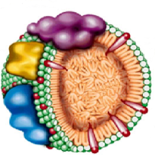
Contributions of metabolic pathways to liver steatosis in obesity
Lipolysis
(60%)
Triglycerides
Fatty
acids
Dietary fat
(10-15%)
Glucose and
Hyperinsulinemia
(25-30%)
DNL
Oxidation
VLDL secretion
Ferre P and Foutelle F. Diab Obes Metab., 2010

Slide 35
Identification of predictors of VLDL₁ TG production in stable isotope kinetic studies
Variable
Beta
SE
Significance
Liver fat (NAFLD)
Plasma glucose
Insulin
Adiponectin
Total abdominal fat
Subcutaneous fat
Intra-abdominal fat
0.22
0.80
0.092
0.38
0.025
0.050
0.49
0.86
0.86
0.50
0.57
Hepatic overproduction of large VLDL is driven by
hepatic TG accumulation and hyperglycemia
Adiels M et al. Diabetologia 2006

Slide 36
Diabetic miliaeu activates transcription factors enhancing DNL in the liver
Glucose
Insulin
+
LXR
+
ChREBP
SREBP1
+
+
Activation of enzymes for De Novo Lipogenesis
In Type 2 diabetes increased glucose and insulin levels
activate both ChREBP and SREBP1 stimulated pathways
that promote DNL and consequently VLDL production
ChREBP, carbohydrate-responsive element-binding protein ; SREBP1, sterol regulatory element-binding protein 1 ; LXR, Liver X receptor

Slide 37
Combining VLDL kinetics and metabolomics data
(n=86)
20h fasting conditions throughout the study
12 h overnight
4 h
8 h
d3-leucine and d5-glycerol
injection for VLDL kinetics
Blood samples
High & low
Hepatic steatosis
T = 0h, 4h, 8h
(n=73)
(n=86)
(n=78)
VLDL
Kinetics
Plasma
Metabolomics
Plasma
Lipidomics
Mardinoglu A. et al. Mol Sys Biol. 2017;13:916

Slide 38
Genome-scale metabolic models (GEMs)
Reactions
Genes
Stochiometric matrix
Glucose
ATP[c]
GCK
ADP[c]
R₁
R₂
R₃
R₄
R₅
R₆
G6P
S
Glucose
G6P
F6P
F16BP
GAP
13BPG
3PG
DHAP
ATP
ADP
NAD+
NADH
Pi
H+
-1
1
0
0
0
0
0
0
-1
1
0
0
0
0
0
-1
10000000000
0
00
-1
1
0000
-1
1000
0
000
-1
1001000000
0000
-1
0000
0
-1
1
-1
1
00000
-1
10
-1
1
0000
GPI
F6P
ATP[c]
Network dependent
analysis
PFK
ADP[c]
F16BP
ALDO
DHAP[c]
TPI
NAD+[c], Pi[c]
GAP
GAPDH
13BPG
ATP[c]
Model
Simulations
PGK
ADP[c]
3PG
Mardinoglu & Nielsen (2012), J Intern Med, 271: 142–154
Mardinoglu, Gatto & Nielsen (2013), Biotechnol J, 8: 985-996
Mardinoglu & Nielsen (2015), COB, 34: 91–97

Slide 39
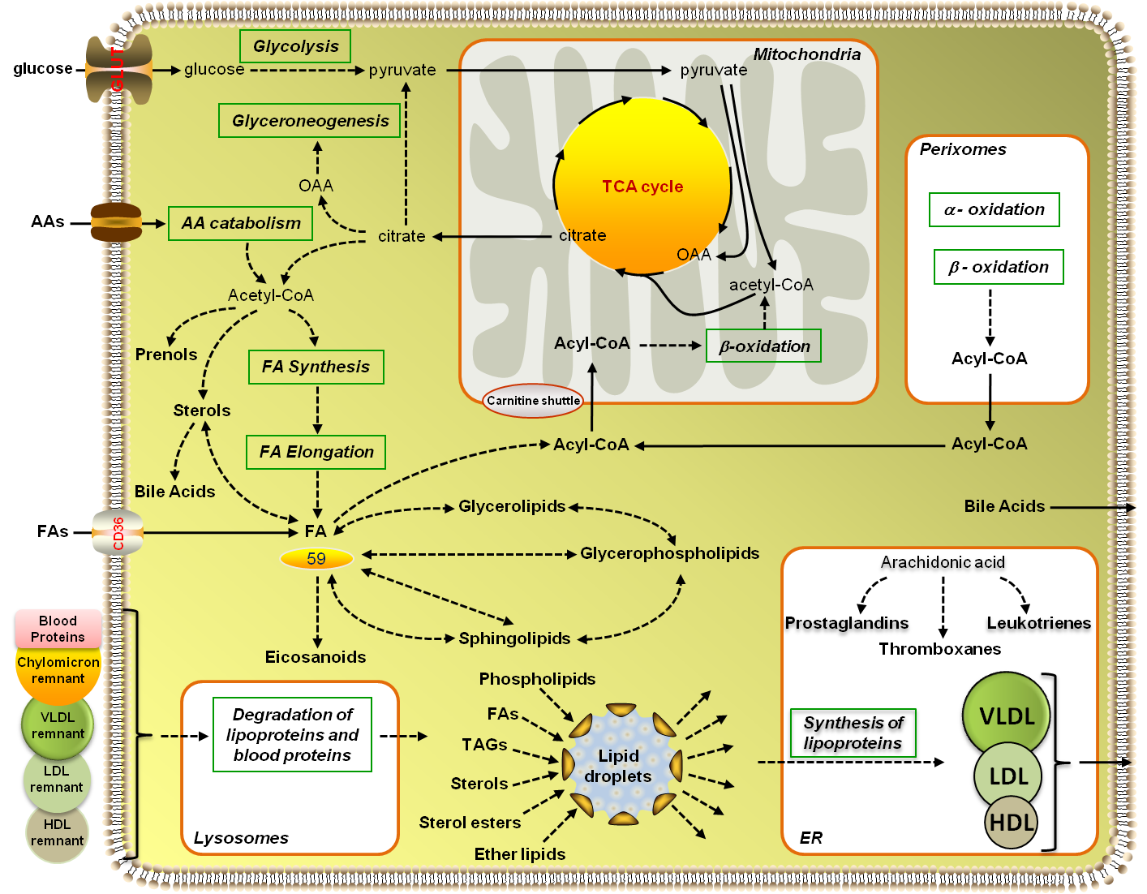
Genome-scale metabolic models (GEMs)
allow metabolic networks to be computationally simulated based on a limited number of constraining measurements, which then enables unmeasured metabolic pathway activities to be inferred
integrate multilayer omics data
incorporate clinical data for personalized medicine
mechanistic perspective that guides feasible therapeutic strategies
iHepatocytes2322
Mardinoglu et. al (2014), Nat Commun, 5: 3083

Slide 40
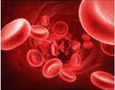
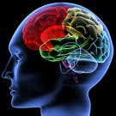

Simulated dynamics of inputs and outputs to the liver used as constrains for GEMs
CO2
Lactate
VLDL
Glucose
Glycerol
FAs
Ketone bodies
Urea
Secretion rates for FAs and AAs from adipose and muscle tissues were calculated based on body composition
Amino acids
Mardinoglu A. et al. Mol Sys Biol. 2017;13:916

Slide 41
Computed personalized GEMs for 73 NAFLD subjects unbalanced redox state and increased demand for glutathione (GSH) and NAD⁺
Liver tissue
glucose[c]
3-phospho-D-glycerate[c]
pyruvate[c]
lactate[c]
PHGDH
NAD+[c]
betaine[c]
NADH[c]
3-phosphonooxypyruvate[c]
PSAT1
glutamate[c]
BCAT1
TCA Cycle
N-acetylglycine[c]
AKG[c]
3-phosphoserine[c]
H2O[c]
PSPH
Pi[c]
ADP[c]
Pi
Glycine[c]
SHMT1
serine[c]
ATP[c]
Glutamine[c]
Glutamate[c]
gamma-glutamyl-
cysteine[c]
GSH[c]
GCLC
GCLM
GSS
ATP[c]
ADP[c]
Pi
Cysteine[c]
NADH[m]
Mitochondria
NNT
NADP+[m]
2 GSH[m]
H2O2[m]
H+[c]
MMR_4271
H+[m]
GSR
MMR_3870
MMR_4121
CAT
NADPH[m]
2 H2O[m]
O2[m]
GSSG[m]
Cytoplasm
NAD+[m]
Fat oxidation
Blue colour indicates down regulation of the genes
Mardinoglu A. et al. Mol Sys Biol. 2017;13:916

Slide 42
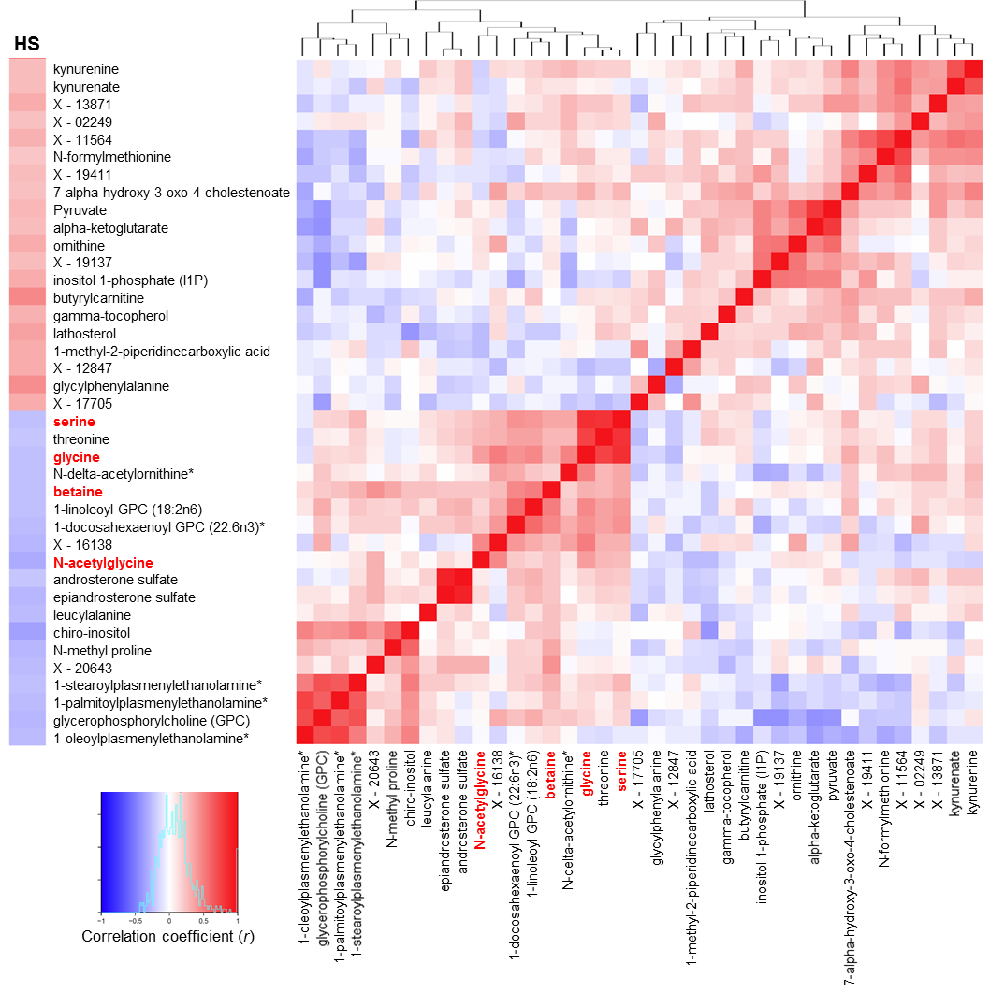
Serum metabolomics indicated GSH deficiency the GSH precursor glycine and its associated metabolites serine, betaine and N-acetylglycine were inversely correlated with disease severity
Mardinoglu A. et al. Mol Sys Biol. 2017;13:916

Slide 43
Serum metabolomics indicated GSH deficiency the GSH precursor glycine and its associated metabolites serine, betaine and N-acetylglycine were inversely correlated with disease severity
Liver tissue
glucose[c]
3-phospho-D-glycerate[c]
pyruvate[c]
lactate[c]
PHGDH
NAD+[c]
betaine[c]
NADH[c]
3-phosphonooxypyruvate[c]
PSAT1
glutamate[c]
BCAT1
TCA Cycle
N-acetylglycine[c]
AKG[c]
3-phosphoserine[c]
serine
glycine
betaine
N-acetyl-glycine
H2O[c]
PSPH
Pi[c]
ADP[c]
Pi
Glycine[c]
SHMT1
serine[c]
ATP[c]
Glutamine[c]
Glutamate[c]
gamma-glutamyl-
cysteine[c]
GSH[c]
GCLC
GCLM
GSS
ATP[c]
ADP[c]
Pi
Cysteine[c]
NADH[m]
Mitochondria
NNT
NADP+[m]
2 GSH[m]
H2O2[m]
H+[c]
MMR_4271
H+[m]
GSR
MMR_3870
MMR_4121
CAT
NADPH[m]
2 H2O[m]
O2[m]
GSSG[m]
Cytoplasm
NAD+[m]
Fat oxidation
Blue colour indicates down regulation of the genes
Mardinoglu A. et al. Mol Sys Biol. 2017;13:916

Slide 44
Transcriptomics in NAFLD subjects livers from NAFLD subjects (n=12) and healthy individuals (n=7)
Liver tissue
glucose[c]
3-phospho-D-glycerate[c]
pyruvate[c]
lactate[c]
PHGDH
NAD+[c]
betaine[c]
NADH[c]
3-phosphonooxypyruvate[c]
PSAT1
glutamate[c]
BCAT1
TCA Cycle
N-acetylglycine[c]
AKG[c]
3-phosphoserine[c]
H2O[c]
PSPH
Pi[c]
ADP[c]
Pi
Glycine[c]
SHMT1
serine[c]
ATP[c]
Glutamine[c]
Glutamate[c]
gamma-glutamyl-
cysteine[c]
GSH[c]
GCLC
GCLM
GSS
ATP[c]
ADP[c]
Pi
Cysteine[c]
NADH[m]
Mitochondria
NNT
NADP+[m]
2 GSH[m]
H2O2[m]
H+[c]
MMR_4271
H+[m]
GSR
MMR_3870
MMR_4121
CAT
NADPH[m]
2 H2O[m]
O2[m]
GSSG[m]
Cytoplasm
NAD+[m]
Blue colour indicates down regulation of the genes
Mardinoglu A. et al. Mol Sys Biol. 2017;13:916

Slide 45
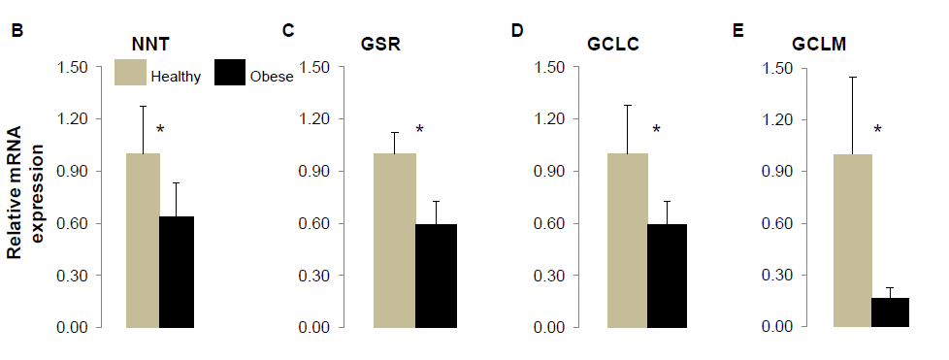
Expression of hepatic genes in obese subjects with high hepatic steatosis
NNT, nicotinamide nucleotide transhydrogenase
GSR, glutathione reductase
GCLC, glutamate-cysteine ligase (rate limiting enzyme of glutathione synthesis)
GCLM, glutamate-cysteine ligase (rate limiting enzyme of glutathione synthesis)
Mardinoglu A. et al. Mol Sys Biol. 2017;13:916

Slide 46
Would it be beneficial to stimulate β-oxidation in fatty liver by supplementation of GSH and NAD⁺ precursors?

Slide 47
Proof of concept study: supplementation of serine to NAFLD subjects
improved markers of liver function and decreased liver fat after supplementation with serine (200 mg/kg per day for 14 days)
Clinical variables | Baseline n=6 | After serine n=6 | P-value
Liver fat (%) | 26.8 ± 6.0 | 20.4 ± 7.0 | <0.05
Age (years) | 56.7 ± 5.2 | 56.7 ± 5.2 | -
Weight (kg) | 103.0 ± 14.3 | 103.0 ± 13.9 | -
Body Mass Index (BMI) (kg/m²) | 32.5 ± 2.70 | 32.5 ± 2.60 | -
Alanine aminotransferase (ALT) (U/L) | 50.8 ± 15.2 | 37.6 ± 5.3 | <0.05
Aspartate aminotransferase (AST) (U/L) | 34.5 ± 8.10 | 27.4 ± 8.4 | <0.05
Alkaline phosphatase (ALP) (U/L) | 76.3 ± 17.2 | 71.3 ± 17.9 | <0.05
γ -Glutamyl transferase (μGT) (U/L) | 63.8 ± 12.9 | 62.3 ± 16.3 | 0.30
Fasting plasma glucose (mmol/L) | 6.57 ± 1.41 | 6.33 ± 1.41 | 0.25
Fasting plasma insulin (FPI) (pmol/L) | 46.3 ± 33.8 | 34.7 ± 25.2 | 0.23
HOMA-IR | 2.15 ± 1.85 | 1.54 ± 1.49 | 0.18
LDL cholesterol (mmol/L) | 3.68 ± 0.80 | 3.85 ± 0.94 | 0.50
HDL cholesterol (mmol/L) | 1.00 ± 0.21 | 1.02 ± 0.18 | 0.30
Plasma triglycerides (TG) (mmol/L) | 6.90 ± 6.65 | 3.63 ± 1.81 | 0.13
Total cholesterol (mmol/L) | 6.23 ± 1.49 | 5.85 ± 1.15 | 0.18
Bilirubin (μmol/L) | 7.33 ± 4.11 | 6.48 ± 3.94 | 0.13
Mardinoglu A. et al. Mol Sys Biol. 2017;13:916

Slide 48
Supplementation of GSH and NAD⁺ precursors for two weeks decreases HFD-induced liver fat accumulation in mice
*nicotinamide riboside, serine and N-acetyl cysteine
Mardinoglu A. et al. Mol Sys Biol. 2017;13:916

Slide 49
Supplementation of GSH and NAD⁺ precursors* for two weeks decreases short-chain triglycerides in the liver
*nicotinamide riboside, serine and N-acetyl cysteine
Mardinoglu A. et al. Mol Sys Biol. 2017;13:916

Slide 50
Can we improve NAFLD and hypertriglyceridemia by reducing carbohydrates in the diet?

Slide 51
Contributions of metabolic pathways to liver steatosis in obesity
Lipolysis
(60%)
Triglycerides
Fatty
acids
Dietary fat
(10-15%)
Glucose and
Hyperinsulinemia
(25-30%)
DNL
Oxidation
VLDL secretion
Ferre P and Foutelle F. Diab Obes Metab., 2010

Slide 52
Hepatic de novo lipogenesis suppresses β-oxidation of long-chain fatty acids
Lipolysis
(60%)
Triglycerides
Fatty
acids
Dietary fat
(10-15%)
Glucose and
Hyperinsulinemia
(25-30%)
DNL
Oxidation
VLDL secretion
DNL generates malonyl-CoA that suppresses importation of long-chain fatty acyl groups into the mitochondria and hence ß-oxidation
Ferre P and Foutelle F. Diab Obes Metab., 2010

Slide 53
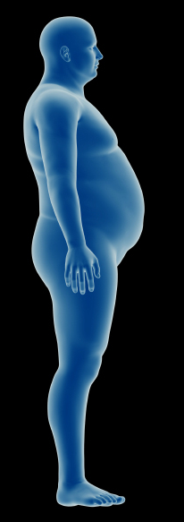
Study design: isocaloric carbohydrate-restricted diet in subjects with NAFLD
Ten middle-aged obese subjects
Clinical characteristics | Mean ± SD
Body mass index, kg/m² | 33.8 ± 3.8
Liver fat, % | 16 ± 7
Alanine transaminase, U/L | 40 ± 16
Aspartate transaminase, U/L | 31 ± 8
Alkaline phosphatases, U/L | 56 ± 19
γ-glutamyl transpeptidase, U/L | 54 ± 38
Glucose, mmol/L | 6.2 ± 0.7
Insulin, mU/L | 22 ± 16
HOMA-IR, U | 6.0 ± 4.5
Plasma cholesterol, mmol/L | 5.3 ± 1.1
HDL cholesterol, mmol/L | 1.1 ± 0.2
LDL cholesterol, mmol/L | 2.9 ± 0.8
Plasma triglycerides, mmol/L | 2.8 ± 1.4
Mardinoglu A et al. 2018 Cell Metabolism

Slide 54
Study design: isocaloric carbohydrate-restricted diet in subjects with NAFLD
Ten middle-aged obese subjects
Served an isocaloric low carbohydrate diet (<30 g carbohydrates per day) for 14 days
Mardinoglu A et al. 2018 Cell Metabolism

Slide 55
Study design: isocaloric carbohydrate-restricted diet in subjects with NAFLD
Phenomics
Ten middle-aged obese subjects
Served an isocaloric low carbohydrate diet (<30 g carbohydrates per day) for 14 days
Multi-layer omics analysis
In parallel cohort (n=7), double liver biopsies
Liver fat, lipids, anthropometric
De novo lipogenesis
Body composition
Days
0 1 2 3 4 5 6 7 8 9 10 11 12 13 14
Inflammatomics
Days
0 1 2 3 4 5 6 7 8 9 10 11 12 13 14
Metagenomics
Days
0 1 2 3 4 5 6 7 8 9 10 11 12 13 14
Metabolomics
Days
0 1 2 3 4 5 6 7 8 9 10 11 12 13 14
Transcriptomics
Days
0 1 2 3 4 5 6 7 8 9 10 11 12 13 14
Mardinoglu A et al. 2018 Cell Metabolism

Slide 56
Rapid decrease of de novo lipogenesis (DNL) and increase of β-oxidation
DNL was analyzed using stable isotope deuterium oxide
Hepatic β-oxidation was assessed indirectly using the surrogate marker β-hydroxybutyrate
Mardinoglu A et al. 2018 Cell Metabolism

Slide 57
Rapid decrease of liver fat
Mean loss of liver fat: 6.4% [range 3.5−8.8%]
Relative loss of liver fat: 43.8% [range: 30.1−74.5%]
Mardinoglu A et al. 2018 Cell Metabolism

Slide 58
Rapid decrease of VLDL-triglycerides and apoC-III
VLDL-triglycerides: 58.1% decrease
Plasma triglycerides: 50% decrease
No differences in IDL, LDL, HDL₂ or HDL₃
Mardinoglu A et al. 2018 Cell Metabolism

Slide 59
Low carb diets are associated with decrased lipogenesis, increased fat-oxidation and reduced steatosis
Low carbs
DNL and β-oxidation
Liver fat
Gut microbiota
Mardinoglu A et al. 2018 Cell Metabolism

Slide 60
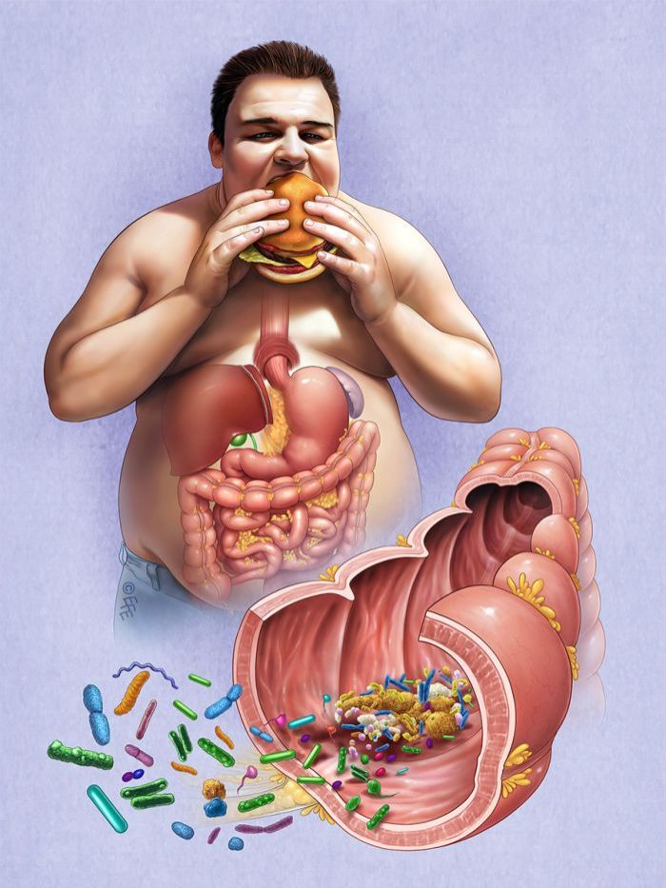
Gut microbiota:
a key player in health and disease
10 times as many cells as in our body
can be viewed as an organ consisting of 500-1,000 cell types
microbiome contains >1000-fold more genes than the human genome (our second genome)
>90% of plasma metabolites originate from gut microbiota
Next-generation sequencing is increasing knowledge about metagenomics

Slide 61
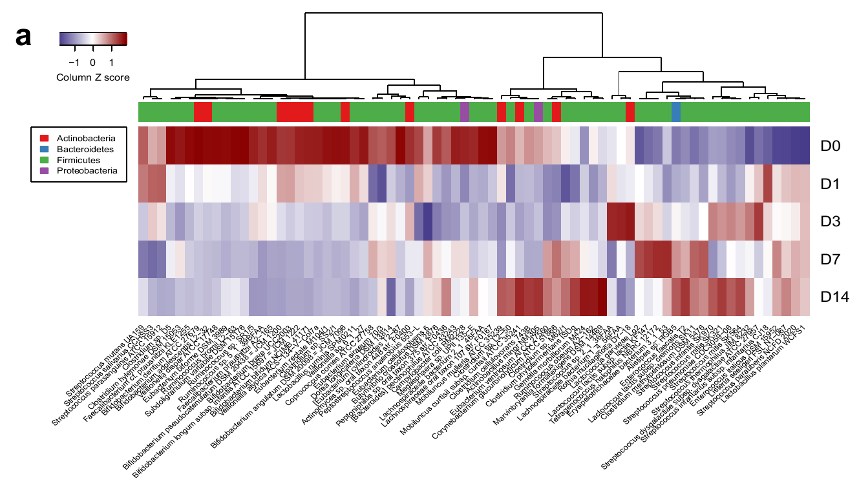
Rapid changes in gut microbiota composition
Mardinoglu A et al. 2018 Cell Metabolism

Slide 62
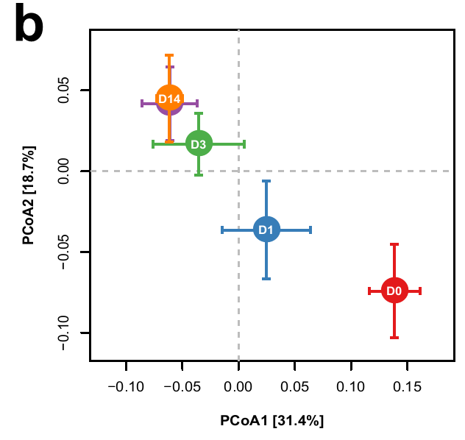
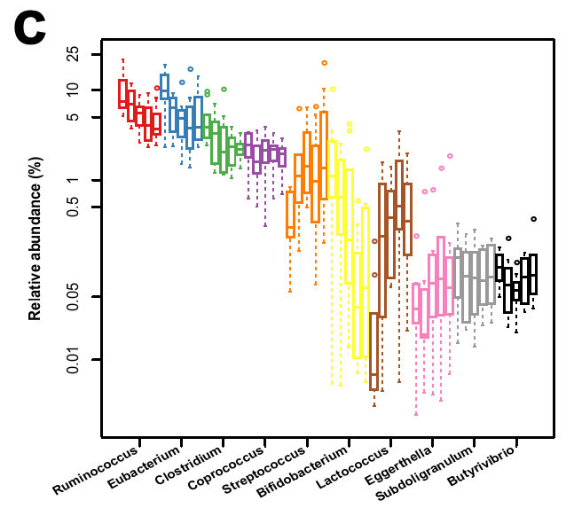
Rapid changes in gut microbiota composition
Gut microbiota mostly Firmicutes changed within one day
Only Streptococcus, Lactococcus and Eggerthella were increased among top 10 genus that are significantly altered upon diet
Mardinoglu A et al. 2018 Cell Metabolism
Notes:
Accordingly, gut microbiota mostly Firmicutes changed within one day; only streptococcus, lactococcus and Eggerthella were increased among top 10 genus that are significantly altered upon diet.

Slide 63
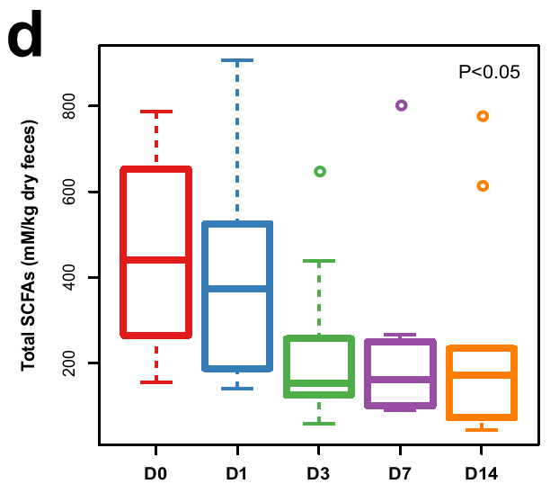
Decreased carbohydrate fermentation reflected from changes of short-chain fatty acids
Mardinoglu A et al. 2018 Cell Metabolism

Slide 64
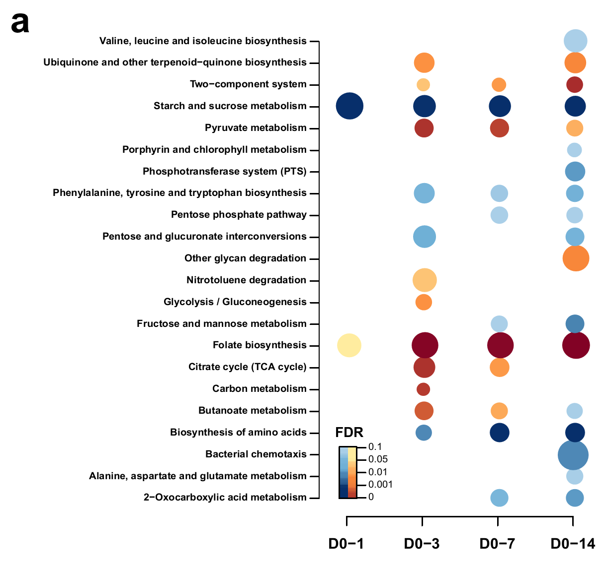
Metagenome annotation revealed that folate biosynthesis was the most enriched pathways whereas starch and sucrose metabolism was significantly decreased
Linking microbiota genome to pathways by annotation using KEGG orthology (KO) database
Only folate biosynthesis significantly increased from the beginning until the end of this study
Bacteria contribute to > 50% of folate
Mardinoglu A et al. 2018 Cell Metabolism

Slide 65
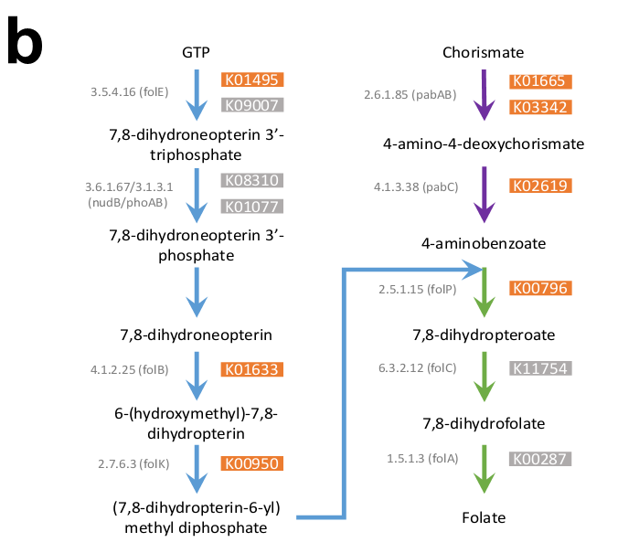
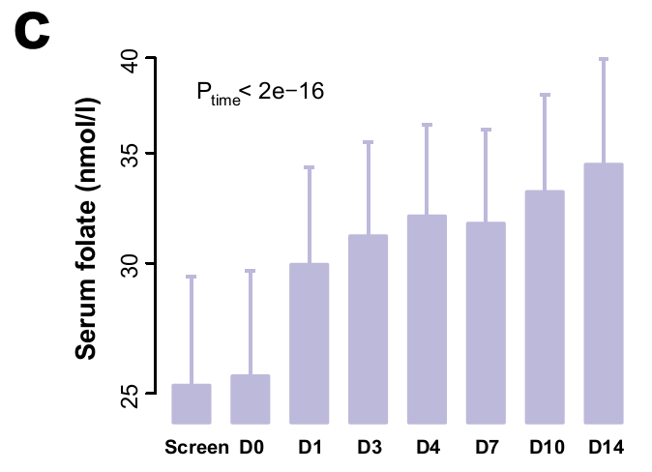
Increased folate biosynthesis and increased serum folate concentrations
Serum folate was strongly increased at day 1 until the end of dietary intervention (no difference in dietary folate)
Detailed KEGG orthology analysis of folate biosynthesis: 7 out of 12 KOs were significantly increased
Mardinoglu A et al. 2018 Cell Metabolism

Slide 66
Untargeted serum metabolomics analysis to investigate how bacterial folate may affect host metabolism
202 out of 648 detected metabolites, most of which belong to lipid and amino acid metabolism, showed significant changes
All 202 metabolites correlated with serum folate, folate biosynthesis pathway (ko00790), and the folate-producing bacteria Streptococcus, Lactococcus, and Eggerthella
Mardinoglu A et al. 2018 Cell Metabolism

Slide 67
Untargeted serum metabolomics analysis to investigate how bacterial folate may affect host metabolism
Results indicate that bacterial folate plays important roles in human lipid metabolism
Metabolites involved in plasmalogen biosynthesis and acyl carnitine mediated fatty acids metabolism were upregulated, indicating enhanced β-oxidation in mitochondrion and peroxisome
Mardinoglu A et al. 2018 Cell Metabolism

Slide 68
Transcriptomics analysis of liver biopsies
double liver needle biopsies performed before and after one week on low carbohydrate-high protein diet (to capture early responses)
performed global transcriptomics analysis to identify differentially expressed pathways
oxidative phosphorylation, NAFLD and insulin secretion were downregulated, whereas carbon metabolism, biosynthesis of amino acids, fatty acid degradation and folate metabolism were upregulated genes
to study the metabolic reprogramming we integrated liver transcriptomics and plasma metabolomics data using GEM iHepatocytes2322
Mardinoglu A et al. 2018 Cell Metabolism

Slide 69
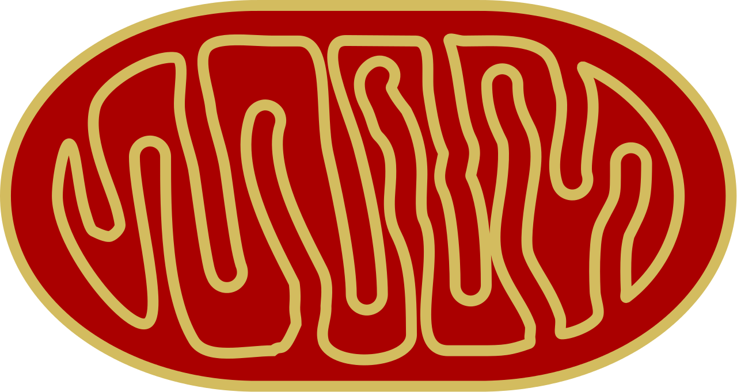
Valine
Leucine
Isoleucine
Glucose
Serine
Fatty acids
Pentose phosphate pathway
Glucose
Fatty acid
biosynthesis
G6P
Serine
3PG
SHMT
Glycine
Fatty acyl-CoA
Folate cycle
Methionine cycle
GSS
GSH
Citrate
NAD⁺
Fatty acid
oxidation
PEP
Branched
amino acids
Acetyl-CoA
Pyruvate
Pyruvate
OAA
Citrate
OAA
AKG
Glutamate
Aspartate
Malate
Malate
Succ-CoA
Mardinoglu A et al. 2018 Cell Metabolism

Slide 70
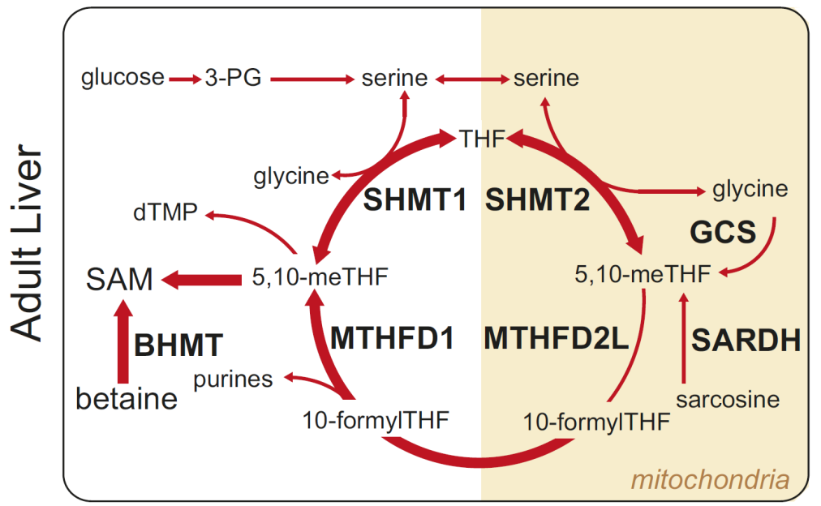
Major folate-dependent one-carbon metabolic pathways in the liver
Mitochondrial respiratory chain dysfunction leads to alterations in one-carbon metabolism pathways
Folate has a key role in regulating one-carbon metabolism, including serine to glycin interconversion
Ducker et al, Cell Metabolism 25, Jan 10, 2017

Slide 71
Valine
Leucine
Isoleucine
Glucose
Serine
Fatty acids
Pentose phosphate pathway
Glucose
Fatty acid
biosynthesis
G6P
Serine
3PG
SHMT
Glycine
Fatty acyl-CoA
Folate cycle
Methionine cycle
GSS
GSH
Citrate
NAD⁺
Fatty acid
oxidation
PEP
Branched
amino acids
Acetyl-CoA
Pyruvate
Pyruvate
OAA
Citrate
OAA
AKG
Glutamate
Aspartate
Malate
Malate
Succ-CoA
Mardinoglu A et al. 2018 Cell Metabolism

Slide 72
Low carb diet associated with reduced steatosis, altered microbiota and increased folate production in humans
Low carbs
DNL and β-oxidation
Liver fat
Gut microbiota
Folate
Serum folate could explain 35.4% and 19.5% of the variation in liver fat before and after adjusting for BMI
Mardinoglu A et al. 2018 Cell Metabolism

Slide 73
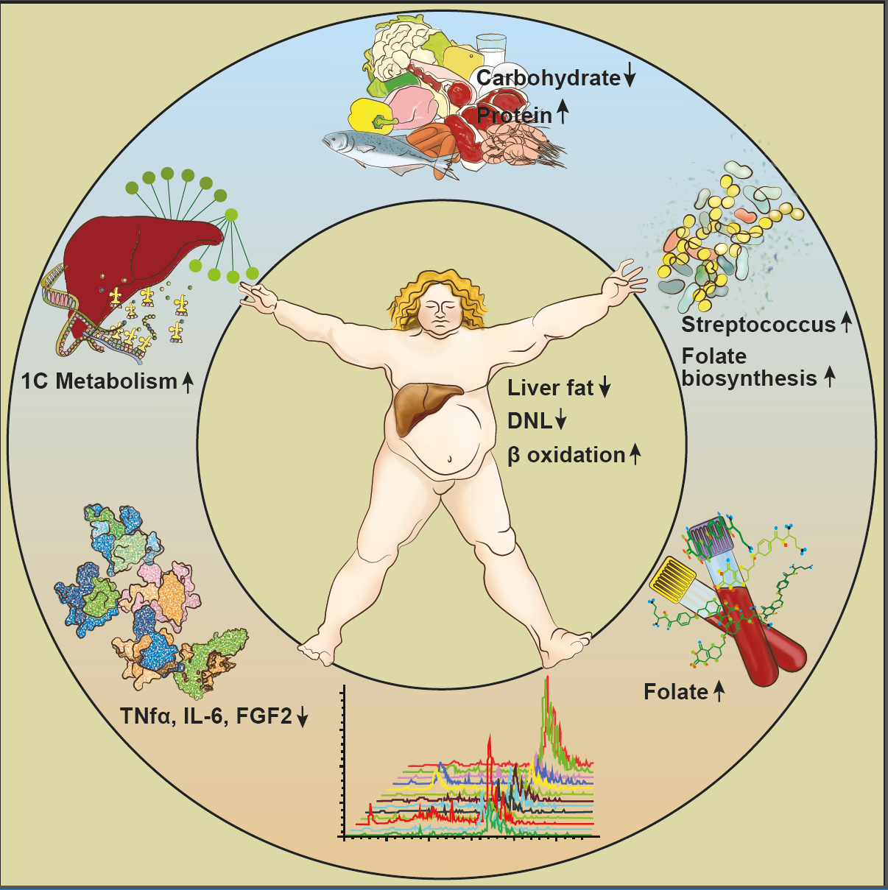
Rapid metabolic benefits of a carbohydrate-restricted diet on hepatic steatosis in NAFLD subjects
A low-carbohydrate diet (LCD) improves liver fat metabolism in NAFLD patients
The LCD promotes rapid shifts in the gut microbiota composition
The microbial changes associate with increased circulating folate
The LCD increases folate-dependent one-carbon metabolism gene expression in liver
Improves cardiometabolic risk-factors
Potential of exploring diet-microbiota interactions for treating NAFLD
Mardinoglu A et al. 2018 Cell Metabolism

Slide 74
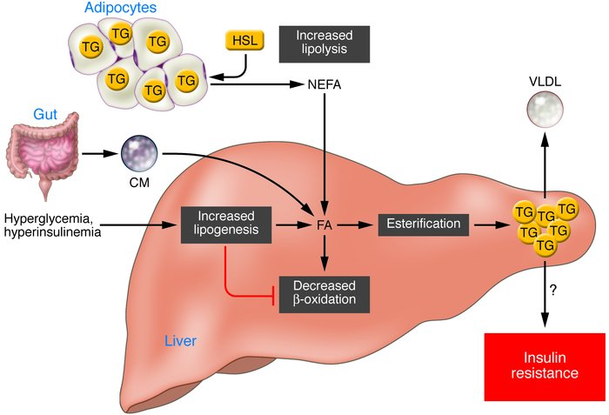
Mechanisms of and targets for NAFLD
Increased lipolysis (increased brown adipose tissue)
Increased lipogenesis (DNL) (carbohydrate-restricted diet, folate)
Decreased hepatic β-oxidation (suppl. of GSH and NAD⁺ precursors)

Slide 75





Acknowledgements
University of Gothenburg
Martin Adiels
Elias Björnson
Eva Hedman Sabler
Elin Stenfeldt
Marcus Ståhlman
Rosellina Mancina
Stefano Romeo
Göran Bergström
Hanns-Ulrich Marschall
Tony Wu
Fredrik Bäckhed
KTH Royal Institute of Technology
Adil Mardinoglu
University of Helsinki, Finland
Marja-Riitta Taskinen
Niina Matikainen
Antti Hakkarainen
Kirsi Pietiläinen
Univ of Western Australia, Perth
Gerald F Watts
P Hugh R Barrett
INSERM CRI 866, Dijon, France
Bruno Vergès
Temple University, US
Kevin J Williams

Slide 76
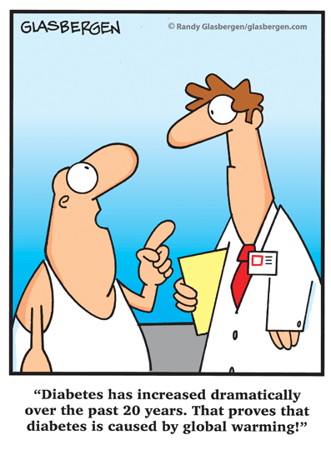
Thank you!
Questions?

